Slide 1

Coronavirus Data Analysis
(using SQL)

Slide 2
SQL Short note…
SQL Stands for Structured Query Language.
A domain-specific language designed for managing and manipulating relational databases.
Used for tasks such as querying data from databases, inserting, updating, and deleting records.
Easy to learn and use across different database management systems such as MySQL, PostgreSQL, and Oracle.

Slide 3
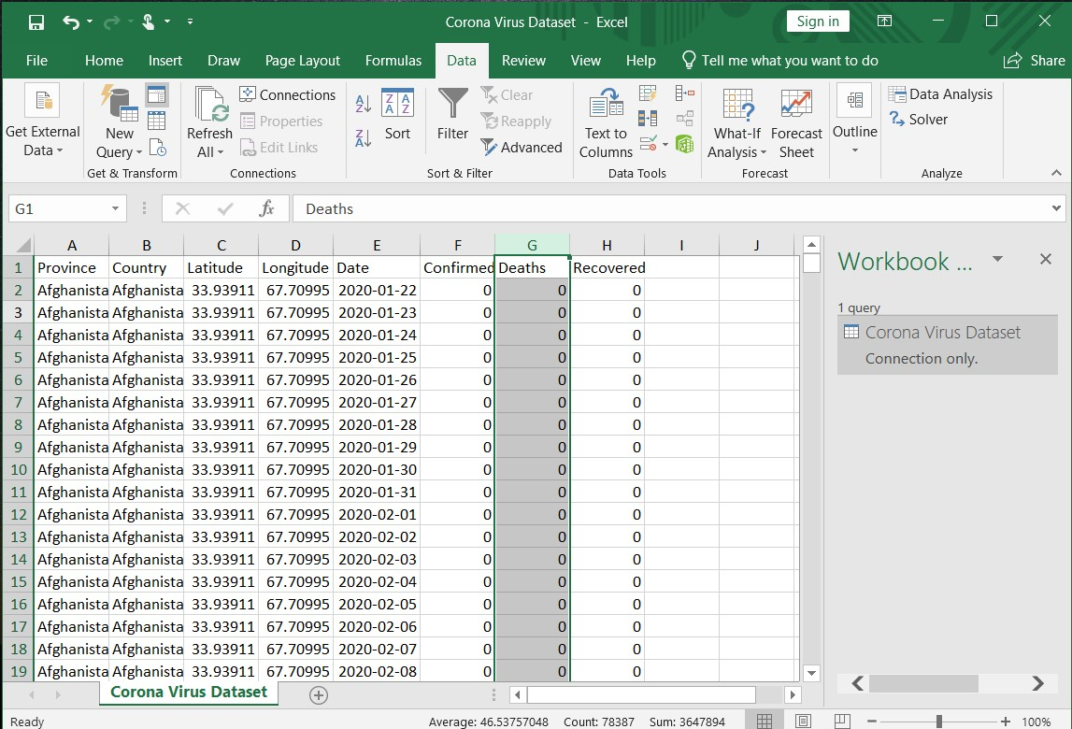
Coronavirus Dataset

Slide 4
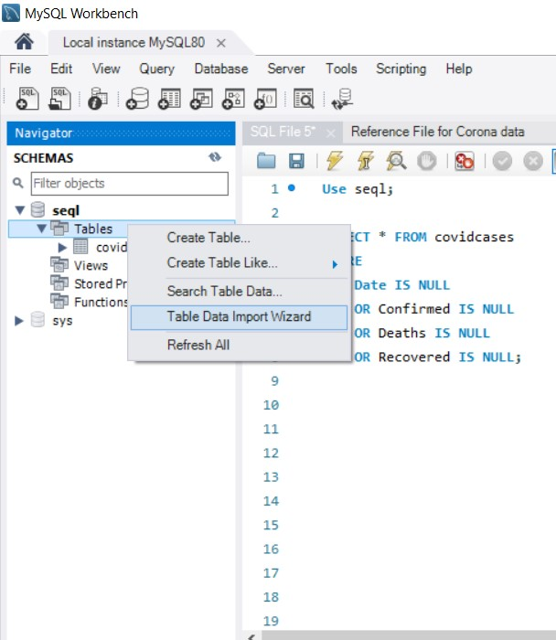
Load Data
After creating the database, initial step is to load the required data for analysis which is corona virus dataset.csv file in our case.
I have uploaded the large dataset using the Table Data Import Wizard option in the MySQL Workbench as shown in the left side image.

Slide 5
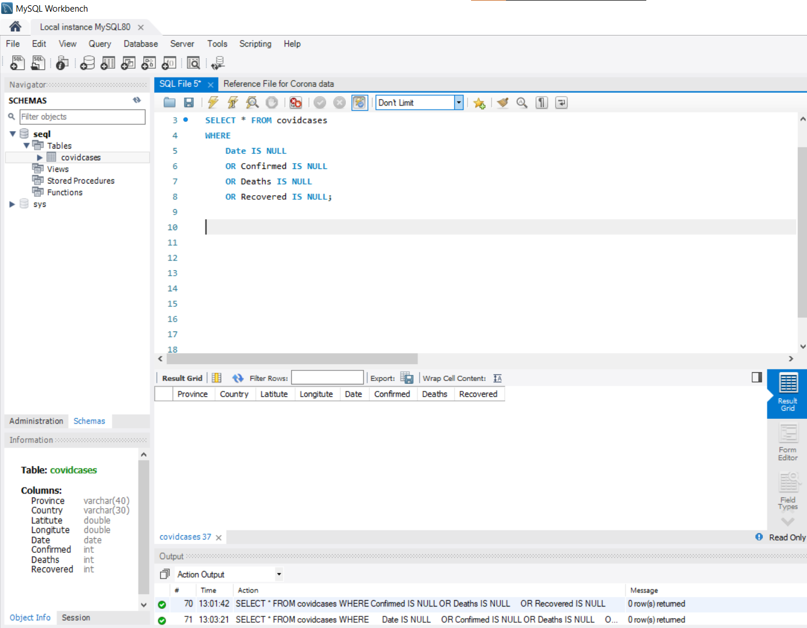
Q1. Write a code to check NULL values

Slide 6
Q2. If NULL values are present, update them with zeros for all columns.
-- No NuLL Values are there in the given dataset.

Slide 7
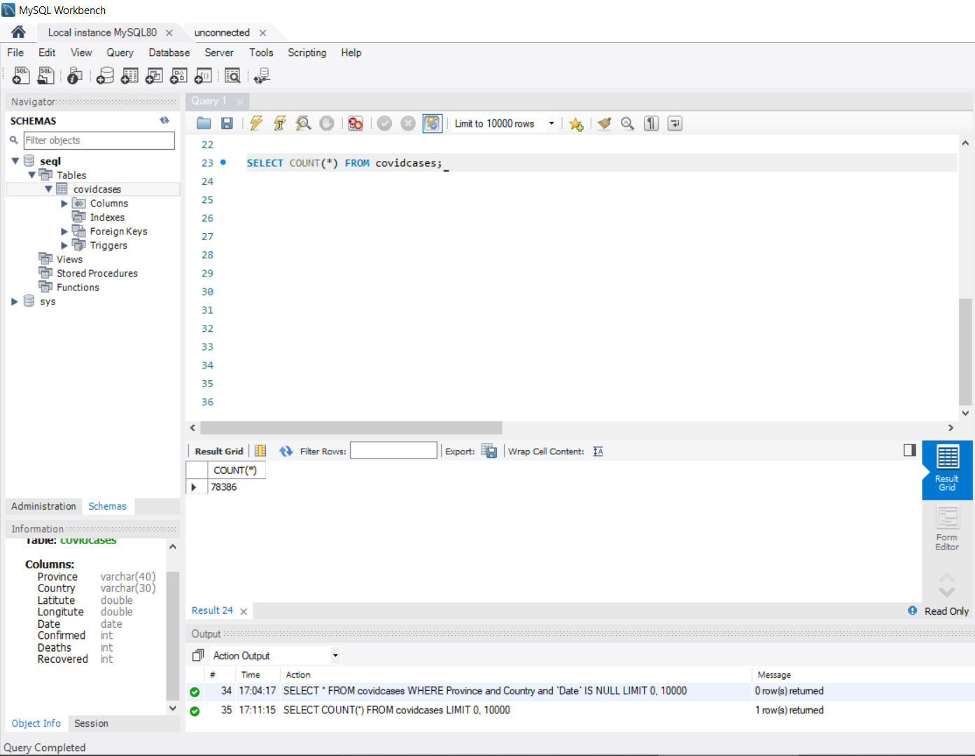

Q3. Check total number of rows

Slide 8
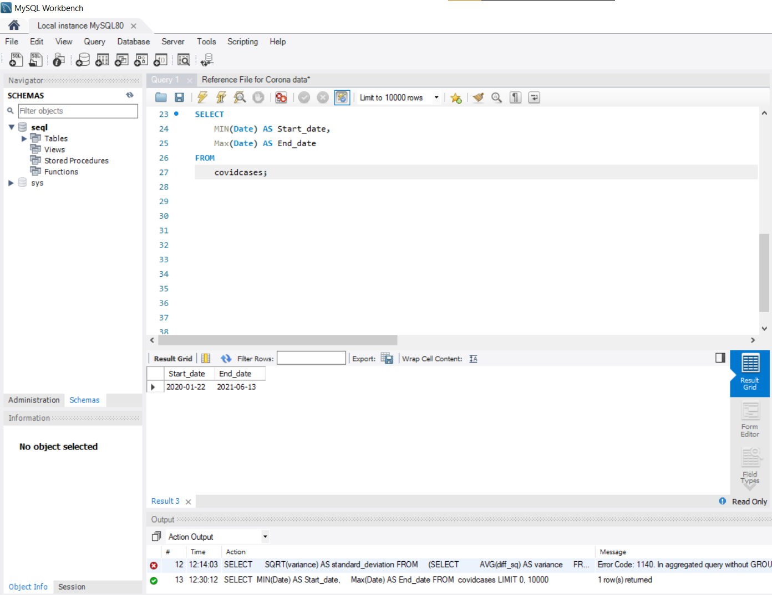
Q4. Check what is start_date and end_date.

Slide 9
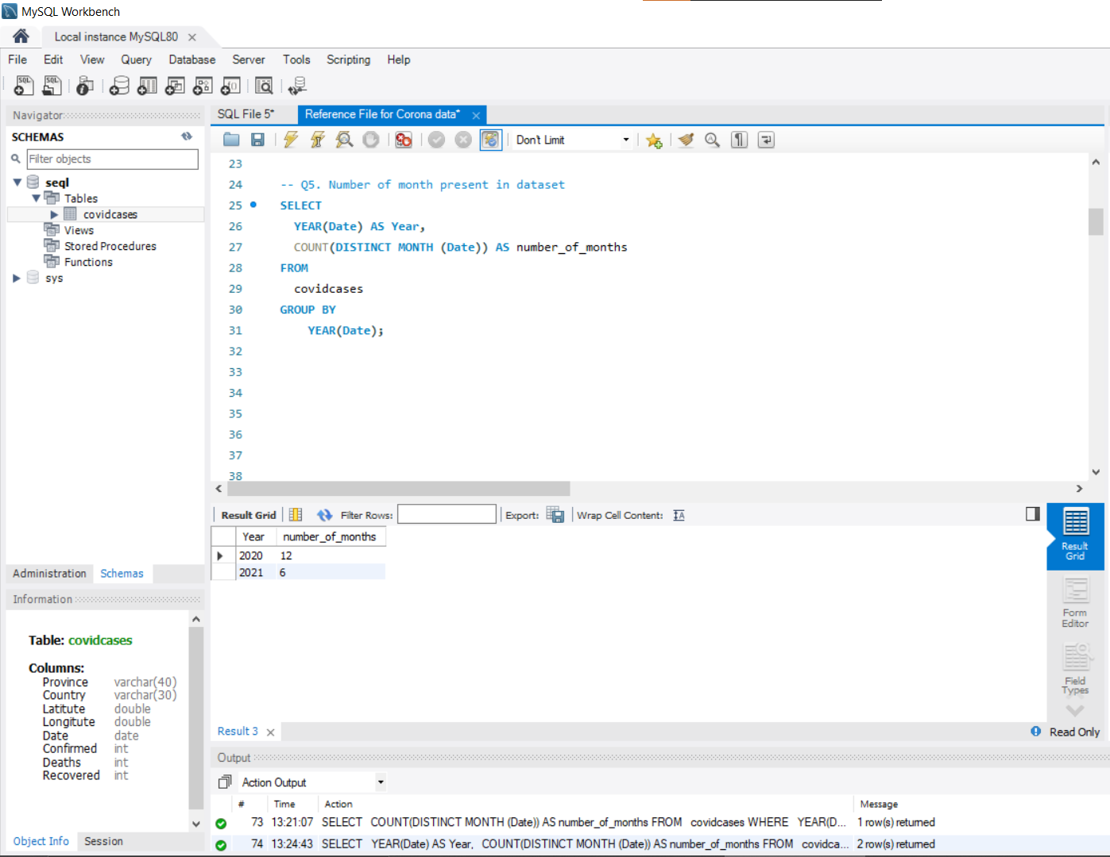
Q5. Number of month present in dataset

Slide 10
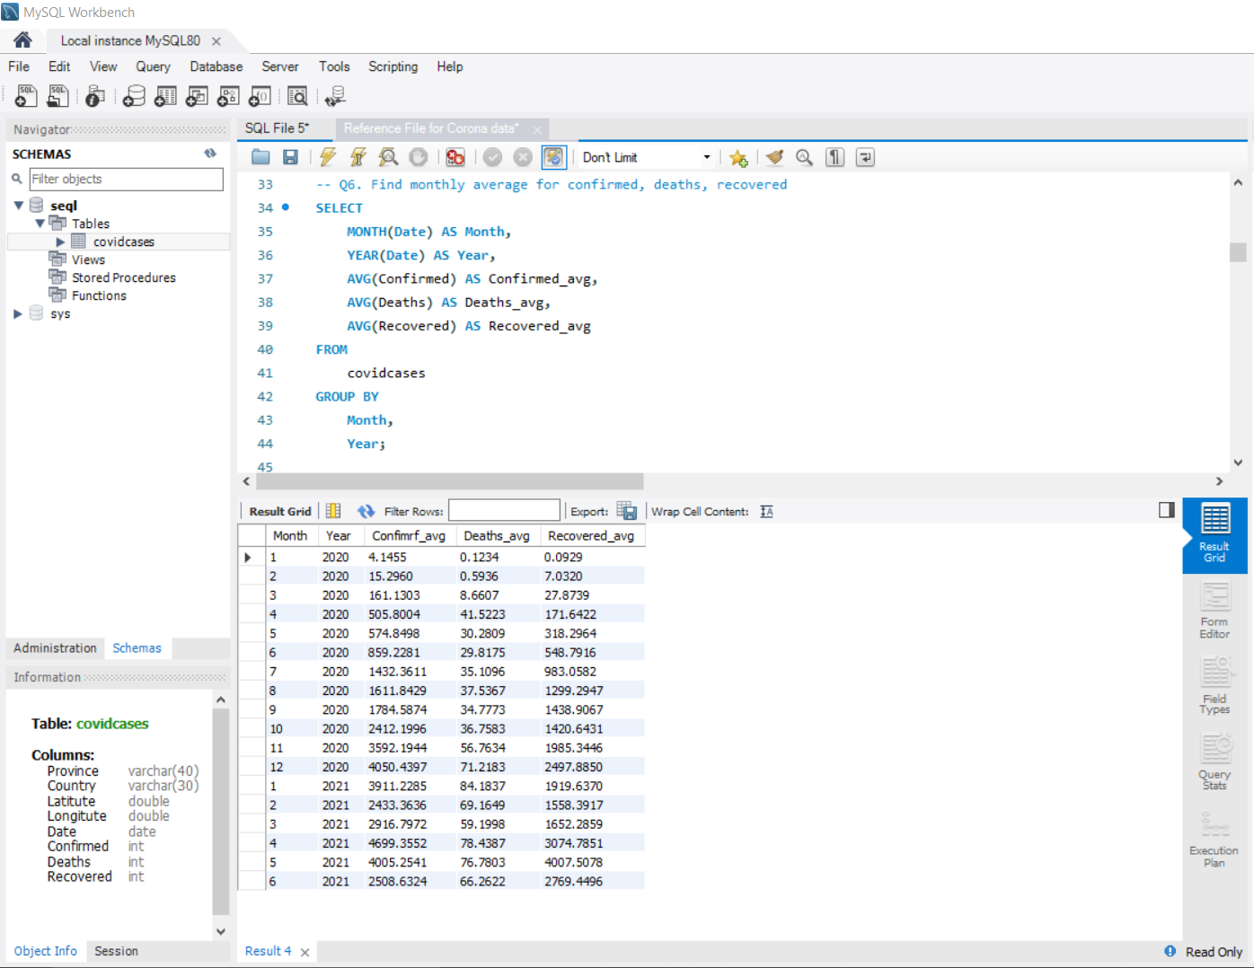
Q6. Find monthly average for confirmed, deaths, recovered

Slide 11
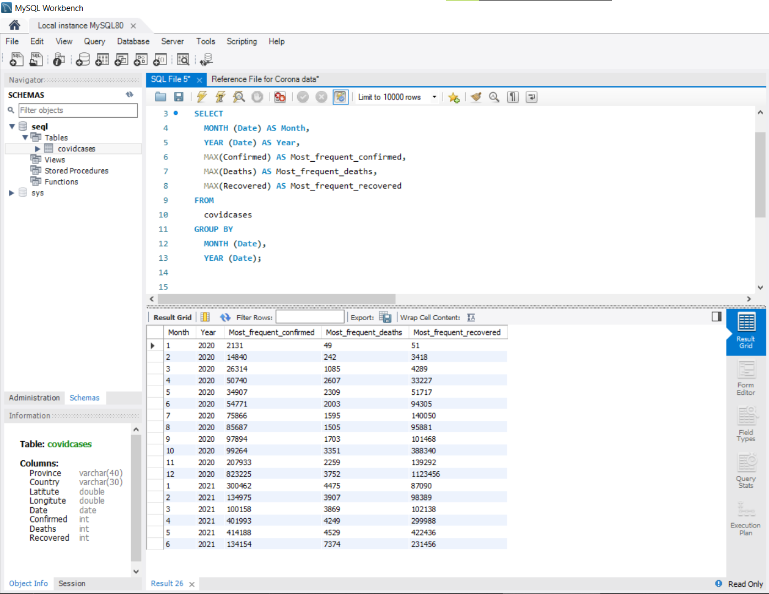
Q7. Find most frequent value for confirmed, deaths, recovered each month.

Slide 12
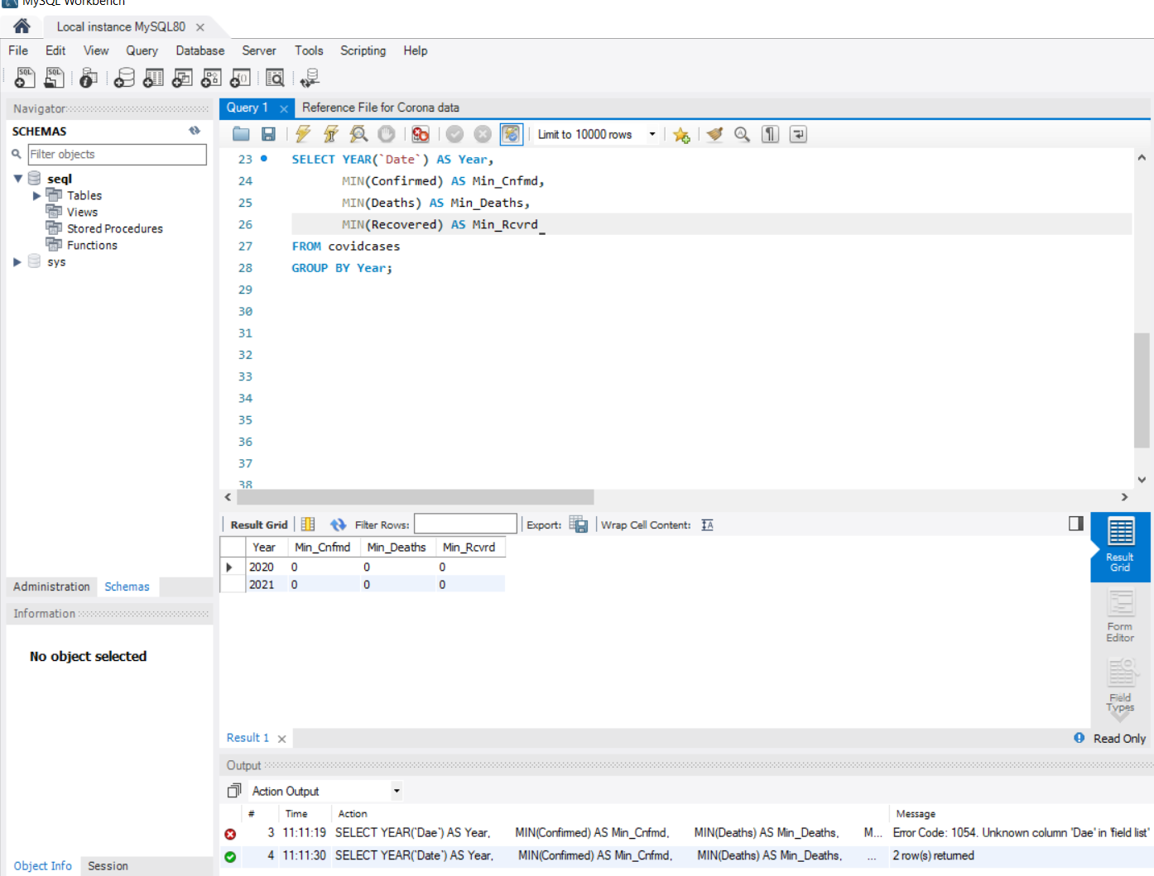
Q8. Find minimum values for confirmed, deaths, recovered per year.

Slide 13
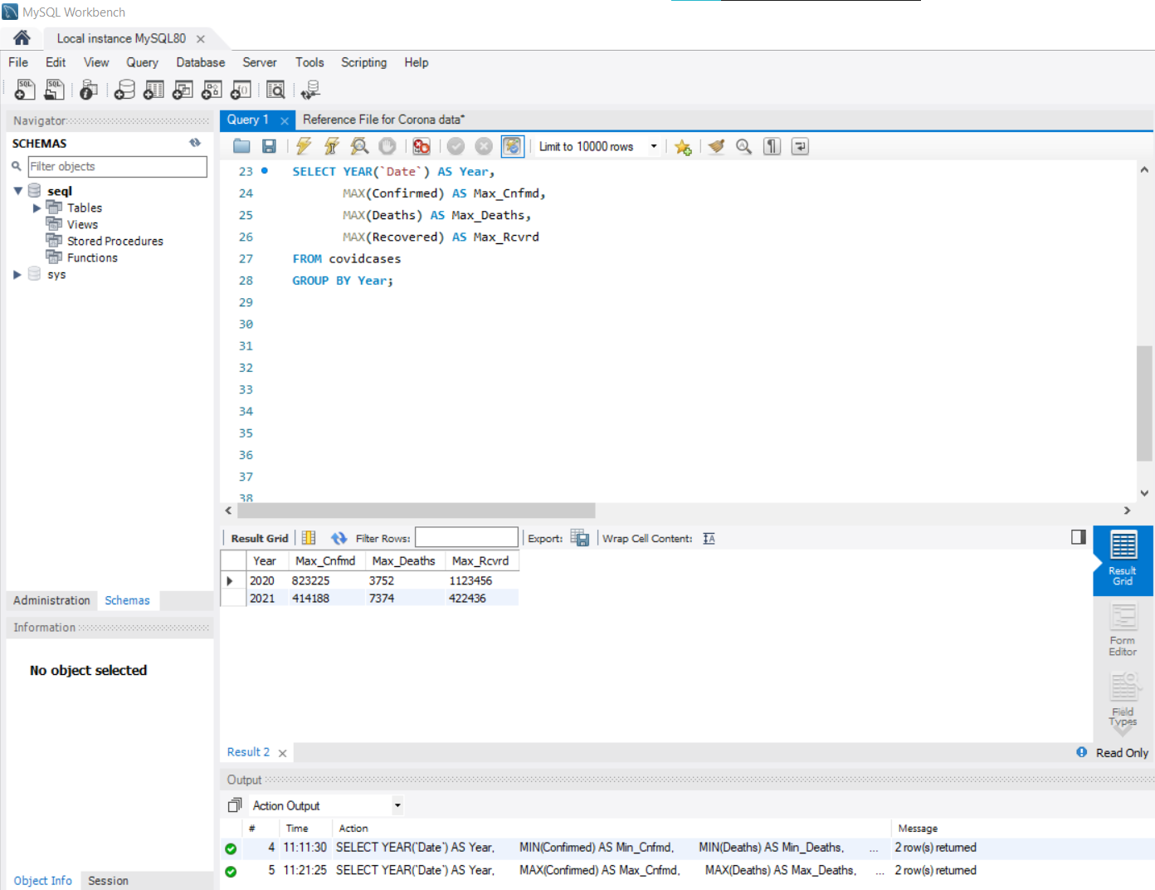
Q9. Find maximum values of confirmed, deaths, recovered per year

Slide 14
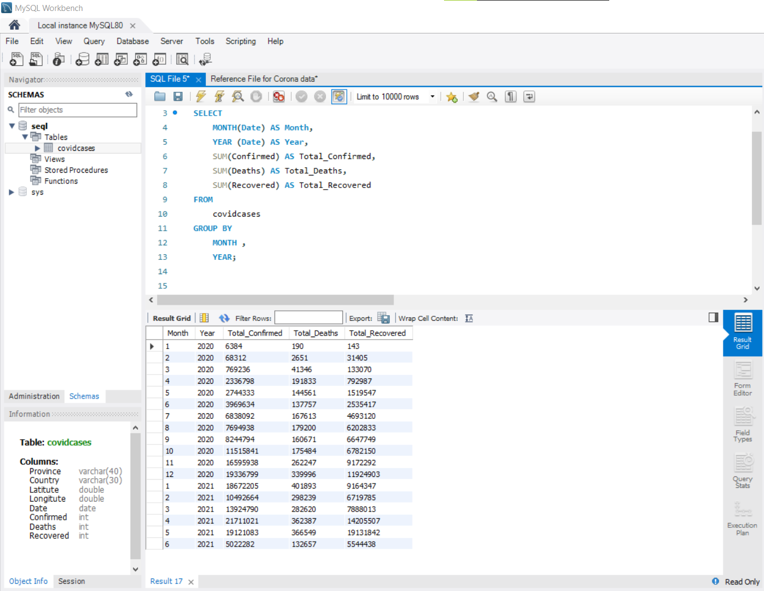
Q10. The total number of case of confirmed, deaths, recovered each month

Slide 15
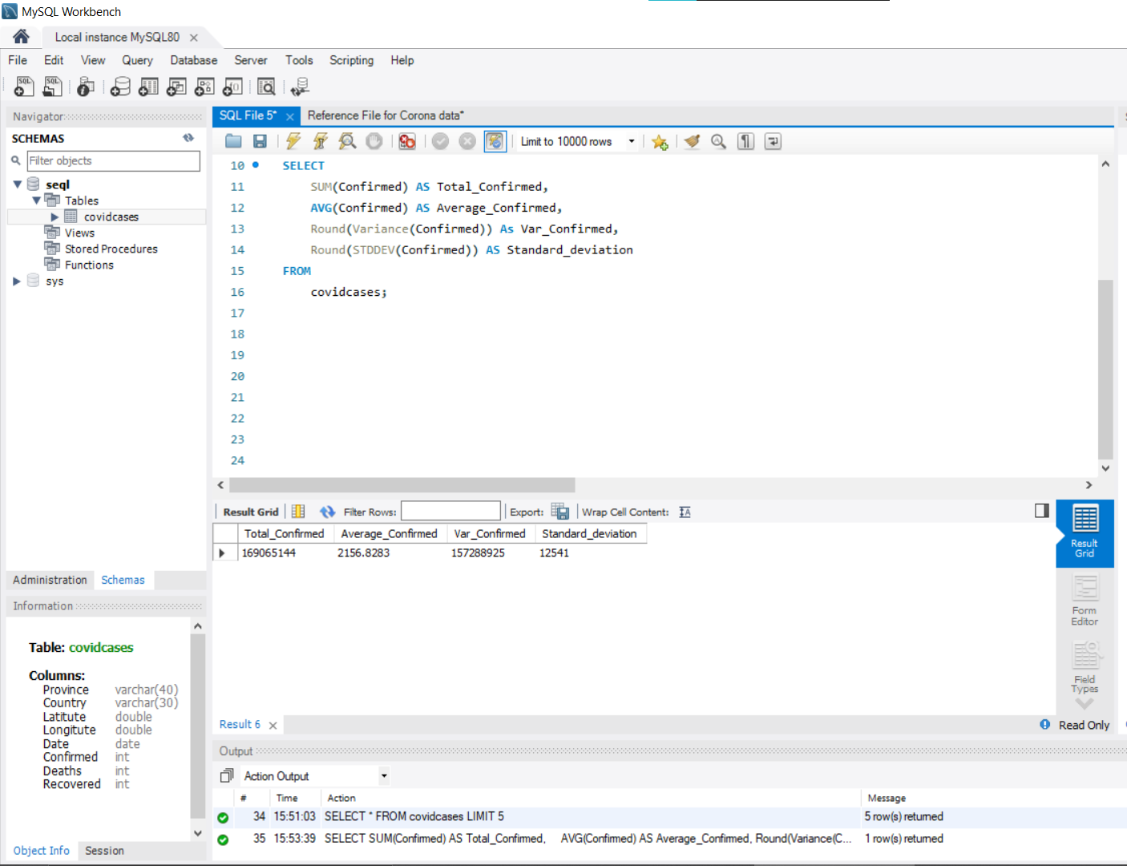
Q11. Check how coronavirus spread out with respect to confirmed case

Slide 16
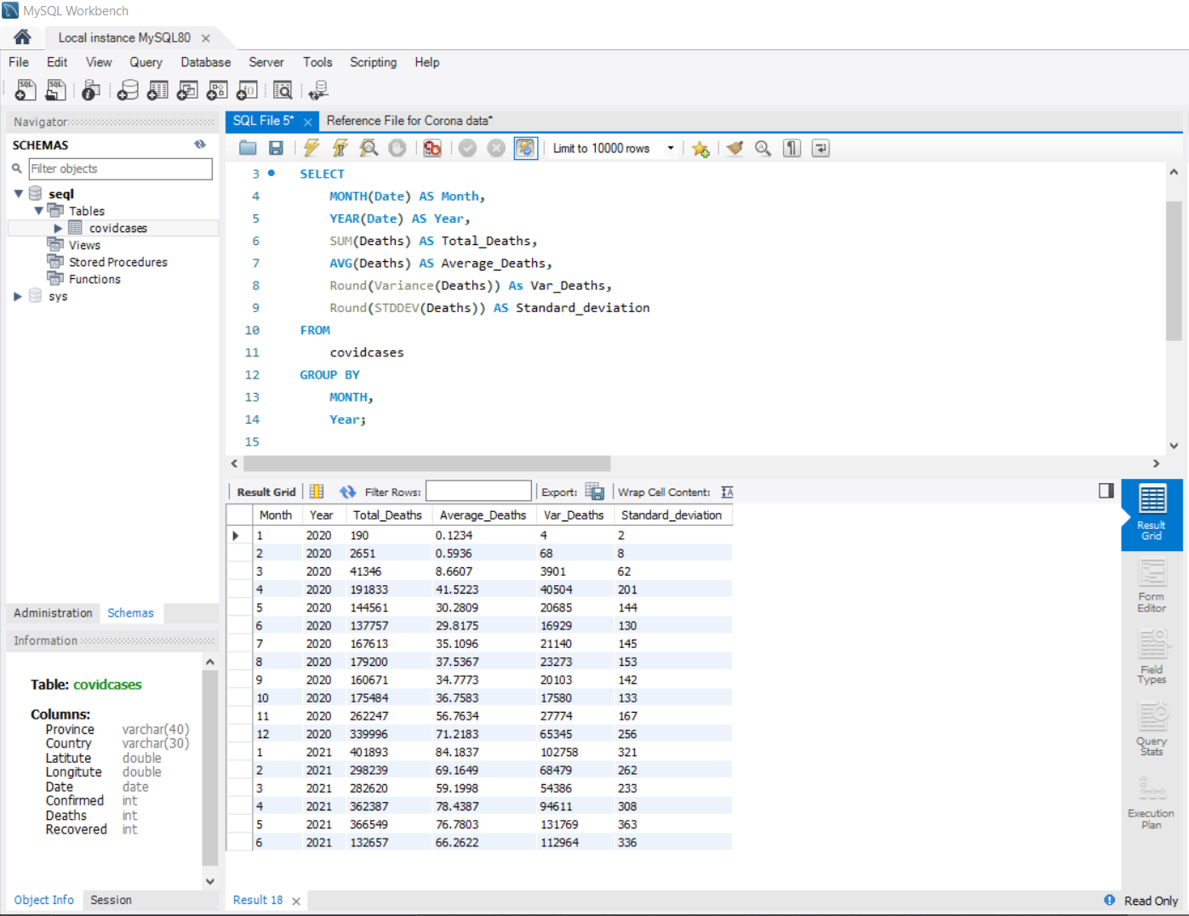
Q12. Check how coronavirus spread out with respect to death case per month.

Slide 17
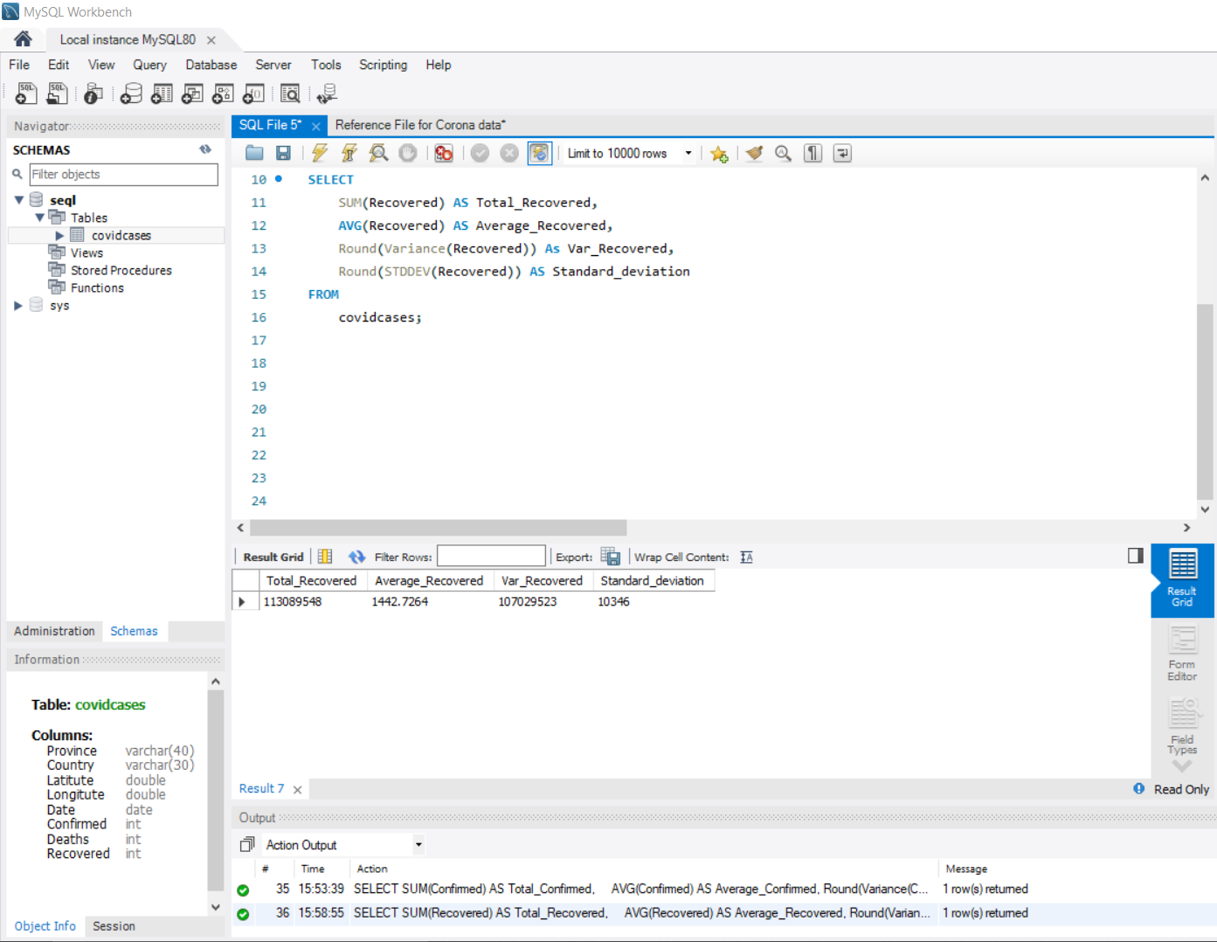
Q13. Check how coronavirus spread out with respect to recovered case

Slide 18
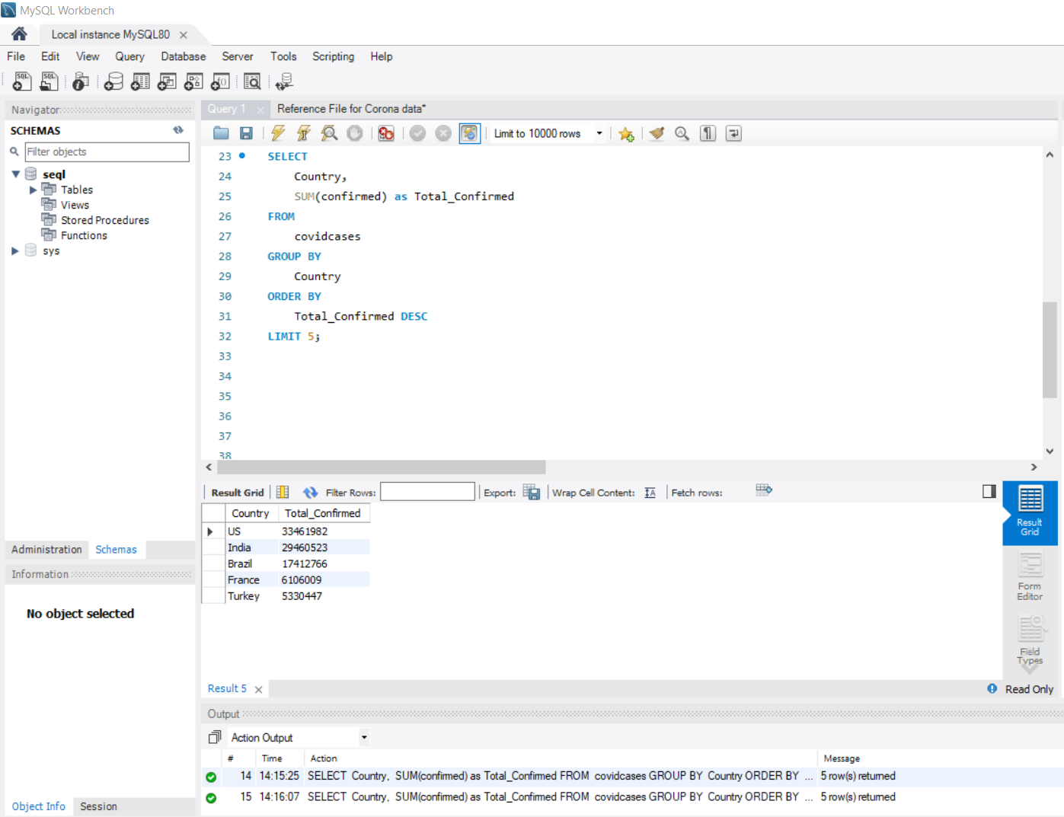
Q14. Find Country having highest number of the Confirmed case

Slide 19
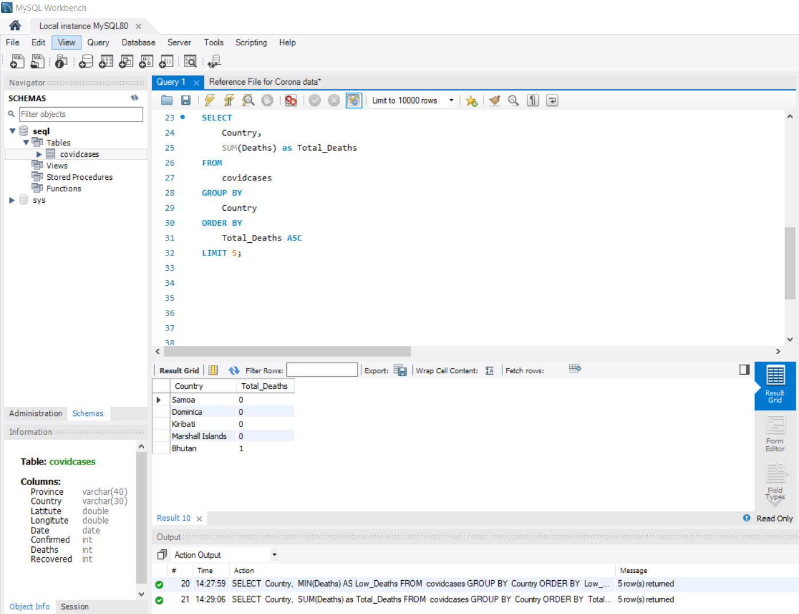
Q15. Find Country having lowest number of the death case

Slide 20
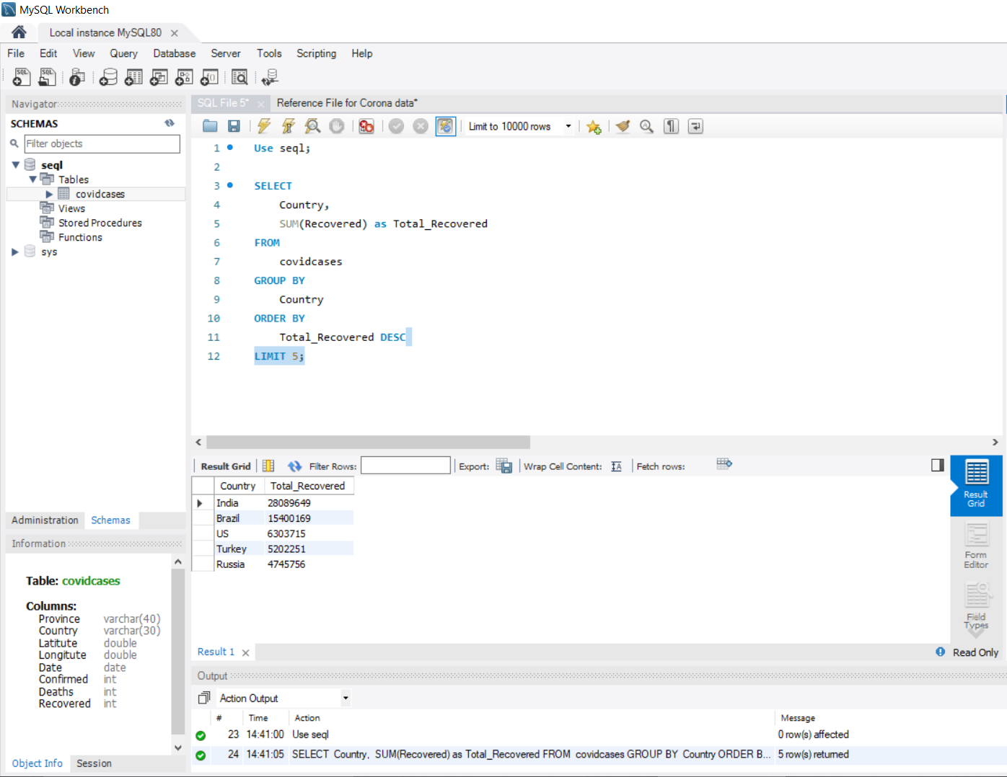
Q16. Find top 5 countries having highest recovered case

Slide 21
Insights
After loading the data, I have checked for the null values and it is clear from the result in slide 5 that there are no null values in the given dataset.
There are totally 78386 records corresponds to different fields such as Country, Date, Confirmed, Deaths, Recovered coronavirus cases in the period of 22/01/2020 till 13/06/2021.
There are 18 months in total on which I have drawn my insights on average confirmed, death and recovered coronavirus cases per month.
‘0’ was the minimum no. of. Confirmed, death and recovered cases recorded in both the years whereas, 3752 people were died and 1123456 people were recovered in the year 2020.
Statistical analysis on the numerical fields resulted in April 2021 being the month with the highest number of 21711021 confirmed cases recorded, while 401893 had the highest number of death cases in the period that happened in January 2021 and 19131842 were recovered in the month of May 2021.

Slide 22
Country-wise analysis clearly shows the US, India, Brazil, France, and Turkey are the top 5 countries that recorded the highest number of COVID-confirmed cases.
Also, the maximum number of people from these countries, except France, were recovered, putting these countries on the top 5 list of recovered cases.
Conclusion
Using MySQL workbench a powerful relational database tool I have uncovered the above essential insights on the coronavirus data with the help of sql queries. All these data-driven points will be helpful for the healthcare field to prepare in advance and combat such viruses in the future.

Slide 23


